Slide 1
Final Project: Control Traffic Lights via Encrypted MQTT
KIJ D
M Adistya Azhar
5116100103

Slide 2
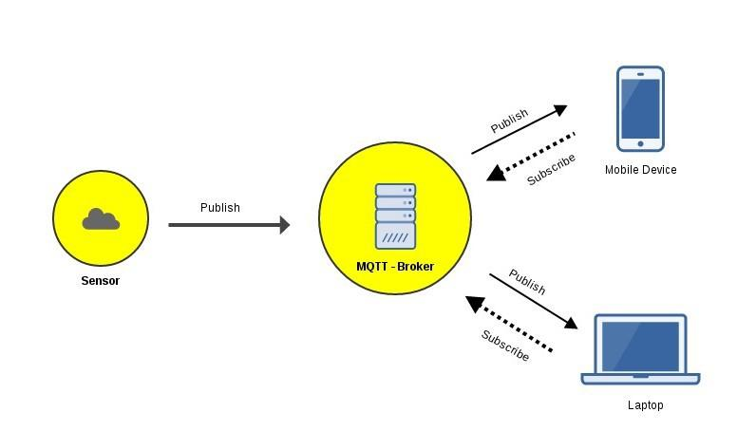
Mengenal MQTT
Protokol MQTT (Message Queuing Telemetry Transport) adalah protokol yang berjalan pada diatas stack TCP/IP dan mempunyai ukuran paket data dengan low overhead yang kecil (minimum 2 bytes) sehingga berefek pada konsumsi catu daya yang juga cukup kecil.
Protokol ini adalah jenis protokol data-agnostic yang artinya anda bisa mengirimkan data apapun seperti data binary, text bahkan XML ataupun JSON dan protokol ini memakai model publish/subscribe daripada model client-server.
Sistem umum IoT memakai MQTT

Slide 3
Keuntungan MQTT
Memiliki QOS
Flexible Subscription pattern
Mengkonsumsi daya rendah
Bekerja secara async

Slide 4
Mengamankan MQTT
Menggunakan username dan password
SSL -> berat dan menambahkan overhead
Enkripsi data yang dikirim dan terima -> menggunakan AES
Mengapa harus diamankan?
Semua pengguna bisa mendapatkan messages yang sedang ditransfer dari/ ke broker asal tahu topicnya. Ini menimbulkan data sensitif ter-expose ke pihak yang tidak berwenang.

Slide 5
AES Steps
Byte Substitution (SubBytes)
The 16 input bytes are substituted by looking up a fixed table (S-box) given in design. The result is in a matrix of four rows and four columns.
Shiftrows
Each of the four rows of the matrix is shifted to the left. Any entries that ‘fall off’ are re-inserted on the right side of row. Shift is carried out as follows −
First row is not shifted.
Second row is shifted one (byte) position to the left.
Third row is shifted two positions to the left.
Fourth row is shifted three positions to the left.
The result is a new matrix consisting of the same 16 bytes but shifted with respect to each other.
MixColumns
Each column of four bytes is now transformed using a special mathematical function. This function takes as input the four bytes of one column and outputs four completely new bytes, which replace the original column. The result is another new matrix consisting of 16 new bytes. It should be noted that this step is not performed in the last round.
Addroundkey
The 16 bytes of the matrix are now considered as 128 bits and are XORed to the 128 bits of the round key. If this is the last round then the output is the ciphertext. Otherwise, the resulting 128 bits are interpreted as 16 bytes and we begin another similar round.

Slide 6
The process of decryption of an AES ciphertext is similar to the encryption process in the reverse order. Each round consists of the four processes conducted in the reverse order −
Add round key
Mix columns
Shift rows
Byte substitution

Slide 7

Cara kerja sistem
Redis Server
Save key
Node Server:
Generate key, encrypt message, publish to mqtt broker
MQTT BROKER
Press button
Publish Topic: led-controls
NodeMCU:
Subscribe topic, get key from redis, decrypt message

